Slide 1


CLOUD-NATIVE BIG DATA ANALYTICS PLATFORM
FOR CROP RECOMMENDATION AND YIELD
FORECASTING
CSA1514 - CLOUD COMPUTING AND BIG DATA ANALYTICS
Presented By:
Daniel Sam K (192524081)
Gnanesh Kumar Naidu (192371051)
M. Srilakshmi (192525404)
Guided By : Dr.R.Latha

Slide 2
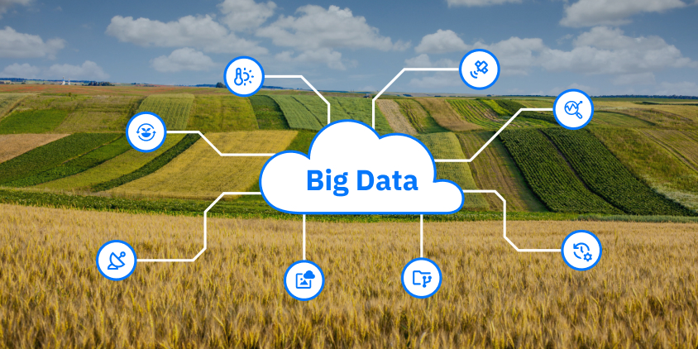
INTRODUCTION
• This project is a cloud-based crop advisory platform for farmers.
• Farmers enter their district, soil details, and growing season.
• The system recommends suitable crops, estimates yield, and displays recent market-price trends.
• Historical weather, soil, yield, and price data are processed using Hadoop and machine learning.
• The web application is designed to make agricultural information easier to access.

Slide 3
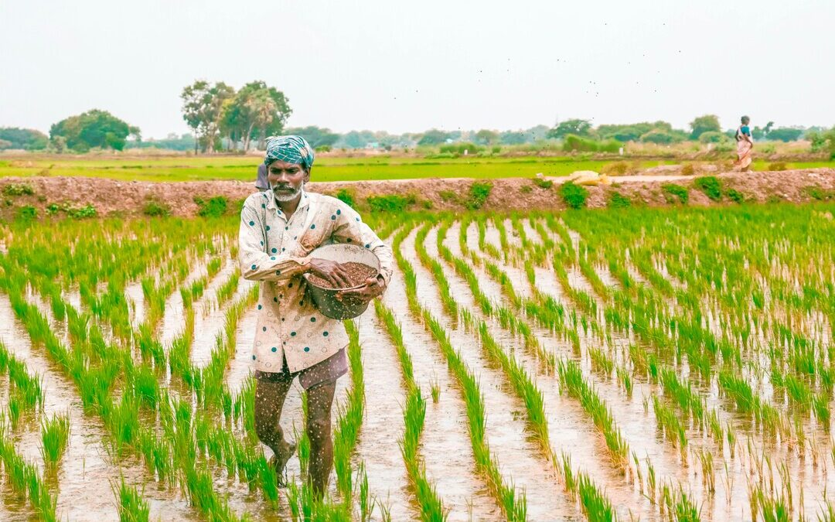
PROBLEM STATEMENT
• Crop choices are sometimes made using habit or guesswork rather than combined data.
• Weather, soil, crop-yield, and market-price information is available from different sources.
• Different formats, missing values, and inconsistent district names make data difficult to use together.
• Farmers need a simple way to view crop suitability, expected yield, and historical price movement.
• This project combines data processing, prediction, and cloud access in one platform.

Slide 4
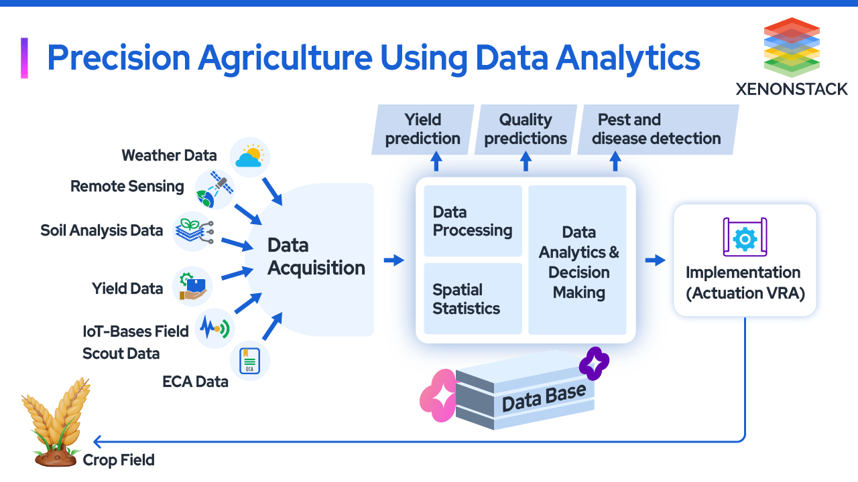
OBJECTIVES
• Collect and combine weather, soil, crop-yield, and market-price datasets.
• Use HDFS and MapReduce to clean and aggregate agricultural data.
• Train machine-learning models for crop recommendation and yield forecasting.
• Build a secure web application that displays predictions and price trends.
• Evaluate processing time, model performance, and API response time.

Slide 5
LITERATURE REVIEW
Author Name | Title of the Paper | Year | Advantages | Limitations
Chunawala et al. | Integrating IoT and Machine Learning for Adaptive Crop Yield Forecasting: A Cloud-Based Approach | 2026 | Combines IoT sensor data with machine learning on a cloud platform for continuous yield forecasting. | Needs IoT sensor setup and constant connectivity.
Shastri et al. | Advancing Crop Recommendation System with Supervised Machine Learning and Explainable Artificial Intelligence | 2025 | Gradient Boosting with explainable AI, evaluated across 22 crop classes. | Trained on a standard benchmark dataset, so real-field performance is not established.
Zhdanov et al. | Ensemble Machine Learning Models for Rice and Wheat Yield Prediction: A Comparative Study Across Districts in India’s Kharif and Rabi Seasons | 2025 | Ensembles tested on 44 districts, including Tamil Nadu, with R² up to 0.94. | Covers only rice and wheat, and needs a separate model per season, district and crop.
Nikhil et al. | Machine Learning-Based Crop Yield Prediction in South India: Performance Analysis of Various Models | 2024 | Compares many models on 34 South Indian districts, including Tamil Nadu; tree-based models reach R² above 0.93. | Data covers 2001 to 2015, so it may be outdated.
Ngo et al. | A Big Data Smart Agricultural System: Recommending Optimum Fertilisers for Crops | 2023 | Uses a big data architecture to give data-driven farming recommendations. | Focuses on fertiliser recommendation rather than crop selection.

Slide 6
System Architecture
A Cloud-Native Big Data Analytics Platform for Crop Recommendation and Yield Forecasting Using Hadoop and Machine Learning
Data Sources
Module 1: Big Data Processing (Hadoop)
Module 2: Machine Learning (Prediction Engine)
Module 3: Cloud Deployment and Web Application
End Users
Weather Data
(temperature, rainfall, etc.)
Data Collection & Ingestion
(CSV / APIs)
Crop Recommendation
(Random Forest Classifier)
Cloud Platform
(IaaS / PaaS / SaaS)
Farmers
Get crop recommendations
View predicted yield
Check price trends
Raw Data
Clean Data
Model Output
REST API
/recommend
/predict-yield
/prices
Results via Web
Soil Data
(N, P, K, pH, etc.)
Hadoop HDFS
Distributed Storage (HDFS)
Yield Forecasting
(Regression Model)
Web Application
Farmer input (district, soil, season)
Crop recommendation
Predicted yield
Price trend
Yield Data
(crop production, etc.)
Model Evaluation
Accuracy (recommendation)
RMSE (yield)
R² (yield)
MapReduce
Data Cleaning & Aggregation
(Hadoop Streaming in Python)
Admin
Manage users
Monitor system
View analytics
Market Price Data
(commodity prices, etc.)
Processed Dataset
(Clean & Merged)
Security
JWT authentication
HTTPS
Roles: Farmer / Admin
Trained Models
(Saved as files)
Technologies Used
Hadoop
HDFS, MapReduce, YARN
Python
Hadoop Streaming, ML
scikit-learn
ML models
FastAPI
REST API
Cloud Services
IaaS, PaaS, SaaS
SQLite
Database
JWT & HTTPS
Security

Slide 7


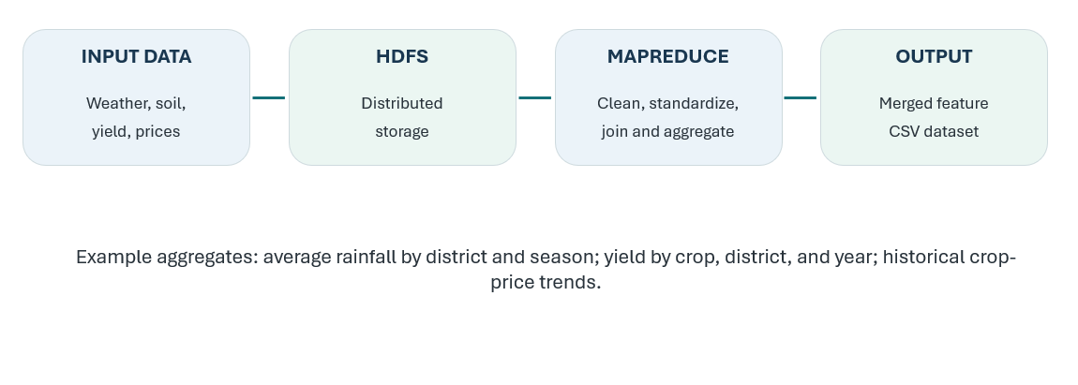
MODULE 1: BIG DATA PROCESSING MODULE
• Collect weather, soil, crop-yield, and market-price datasets.
• Store the collected files in HDFS (Hadoop Distributed File System).
• Use Hadoop MapReduce with Python Streaming to clean, join, and aggregate records.
• Tune block size (planned: 128 MB), replication factor, and reducer count; measure processing time against data size.
• Produce a clean merged dataset and record the MapReduce benchmark.

Slide 8
MODULE 1: OUTPUT

Slide 9


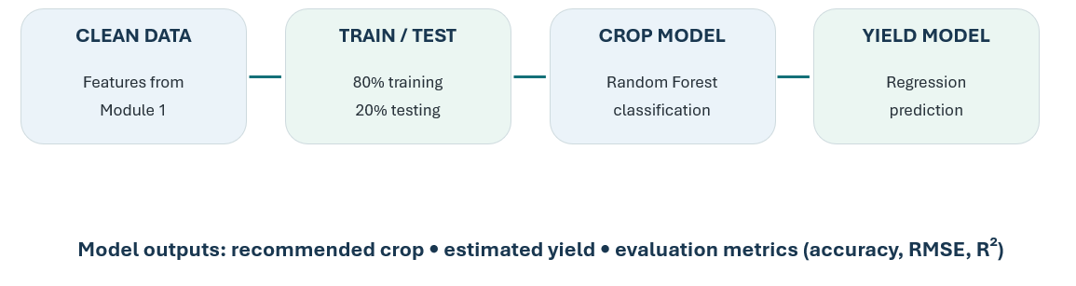
MODULE 2: MACHINE LEARNING MODULE
• Load the cleaned agricultural dataset prepared by Module 1.
• Train a Random Forest classifier to recommend suitable crops.
• Train regression models to estimate expected crop yield.
• Tune Random Forest settings using 100–200 trees and depth 10–20 with an 80/20 train-test split.
• Evaluate crop recommendation with accuracy and yield prediction with RMSE and R²; save trained models.

Slide 10
MODULE 2: OUTPUT

Slide 11
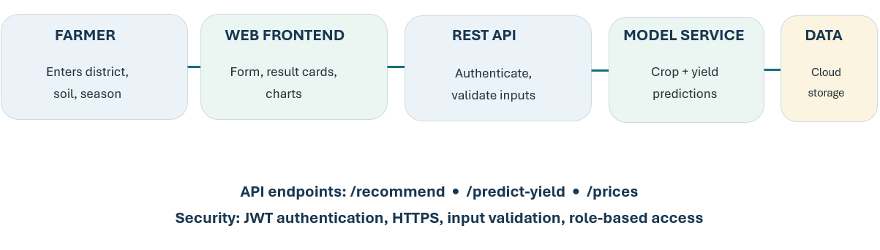
MODULE 3: CLOUD DEPLOYMENT AND
WEB APPLICATION
• Build a farmer-friendly page that accepts district, soil details, and season.
• Connect REST API endpoints for crop recommendation, yield prediction, and market-price trends.
• Deploy the backend and frontend on cloud infrastructure and store datasets and model files in cloud storage.
• Protect access using JWT login, bcrypt password hashing, HTTPS, and farmer/admin roles.
• Test API response time with a target of under 2 seconds and show the results clearly.

Slide 12
MODULE 3: OUTPUT

Slide 13

LIMITATIONS
• Public datasets may contain missing values, inconsistent district names, or gaps between years.
• Crop yield depends on factors that may not be present in the data, such as pests, irrigation, and farming practices.
• A crop recommendation dataset from outside Tamil Nadu may not fully represent local conditions.
• Historical prices show trends but cannot guarantee future market prices.
• The system provides data-based guidance, not a guarantee of yield or profit; local validation is needed.

Slide 14
CONCLUSION
The platform helps farmers make better agricultural decisions using data instead of guesswork.
Hadoop HDFS and MapReduce store, clean and process the weather, soil, crop-yield and market-price datasets.
Random Forest classification and regression models recommend suitable crops and predict expected yield.
The web application takes the farmer’s district, soil details and season, and shows crop recommendations, yield predictions and price trends.
Cloud services, REST APIs, JWT login and HTTPS make the system accessible and protect user information.
The project is evaluated using data processing time, model performance metrics (accuracy, RMSE, R²) and API response time.

Slide 15
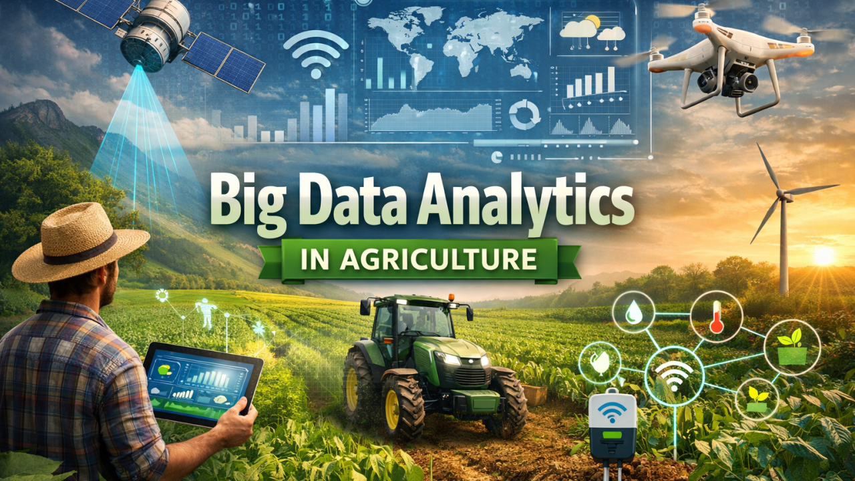
FUTURE SCOPE
• Add regularly updated weather and market-price feeds.
• Validate recommendations with Tamil Nadu district-level records and agricultural experts.
• Add Tamil-language support and a mobile-friendly interface.
• Introduce SMS or mobile notifications for relevant crop and price updates.
• Scale the data pipeline to more districts, states, crops, and longer historical periods.

Slide 16

REFERENCES
Chunawala, H., Chunawala, P., Dhaygude, A. D., Yadav, L. N., Jain, S., Swarnkar, S. K., & Nahak, K. (2026). Integrating IoT and machine learning for adaptive crop yield forecasting: A cloud-based approach. In M. Saraswat, A. Rajan, & A. Chakravorty (Eds.), Congress on Smart Computing Technologies (CSCT 2024) (Smart Innovation, Systems and Technologies, Vol. 122, pp. 305–317). Springer. https://doi.org/10.1007/978-981-96-6250-0_21
Shastri, S., Kumar, S., Mansotra, V., et al. (2025). Advancing crop recommendation system with supervised machine learning and explainable artificial intelligence. Scientific Reports, 15, Article 25498. https://doi.org/10.1038/s41598-025-07003-8
Zhdanov, V., Kaplin, D., Akimov, M., Antonov, A., Gasanov, M., & Malchenko, V. (2025). Ensemble machine learning models for rice and wheat yield prediction: A comparative study across districts in India’s Kharif and Rabi seasons. Journal of the Indian Society of Remote Sensing, 53(11), 3901–3915. https://doi.org/10.1007/s12524-025-02186-z
Nikhil, U. V., Pandiyan, A. M., Raja, S. P., & Stamenkovic, Z. (2024). Machine learning-based crop yield prediction in South India: Performance analysis of various models. Computers, 13(6), Article 137. https://doi.org/10.3390/computers13060137
Ngo, V. M., Duong, T.-V. T., Nguyen, T.-B.-T., Dang, C. N., & Conlan, O. (2023). A big data smart agricultural system: Recommending optimum fertilisers for crops. International Journal of Information Technology, 15(1), 249–265. https://doi.org/10.1007/s41870-022-01150-1

Slide 17
THANK YOU

